Slide 1

Arduino programming
BY: ENG. Aya Ali Kamal

Slide 2
Agenda
C++ overview.
Micro processors VS Micro controllers.
Types of Micro controllers.
Arduino:
Hardware.
Software.

Slide 3
C++ Overview
# define:
Definition.
Used to define constants or pin.

Slide 4
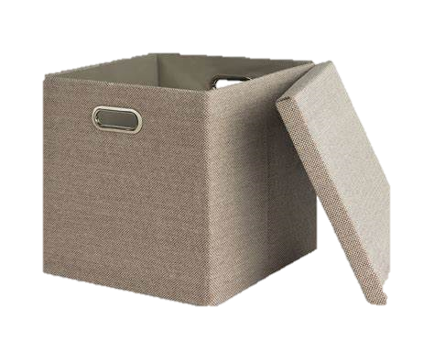
C++ Overview
Constants & variables:
Box.
Constants.
Variable types

Slide 5
C++ Overview
Constants & variables:
Box.
constants.
Variable types
Floats
Int
Double
String
Char
Byte
Bool
Uint8
Uint16

Slide 6
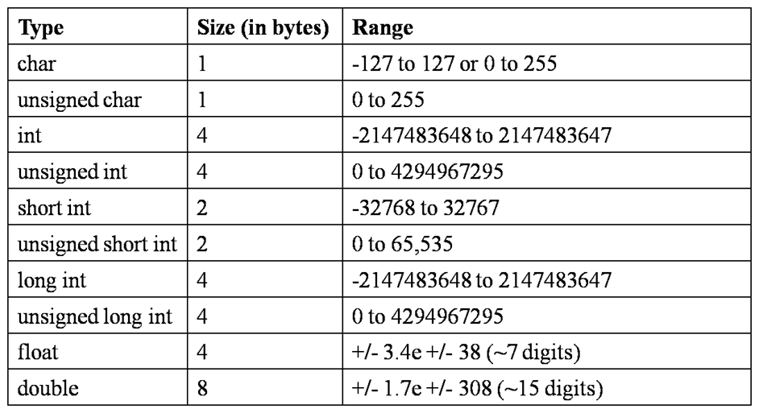


Variables size:

Slide 7
C++ Overview
#include:
Wanting to include file.
#include < Arduino.h>.
#include “Arduino.h”.

Slide 8
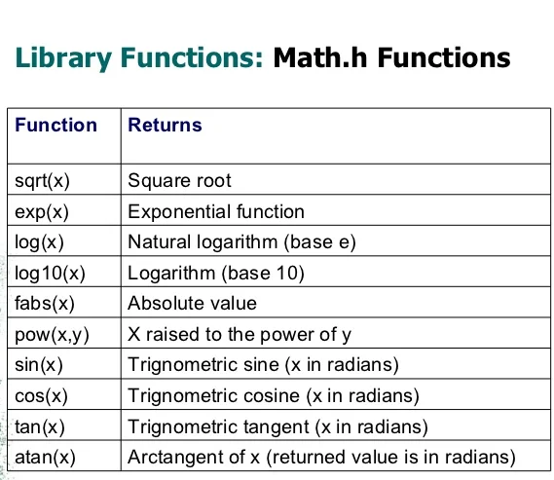
C++ overview:
Math.h
Arduino.
c math
C++.

Slide 9
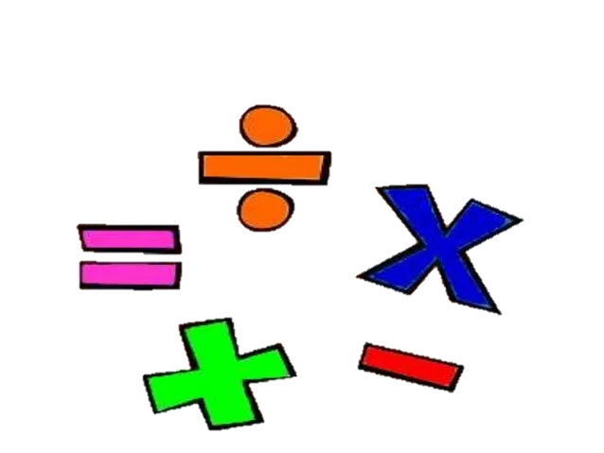
C++ Overview
Operators:
Operations.

Slide 10
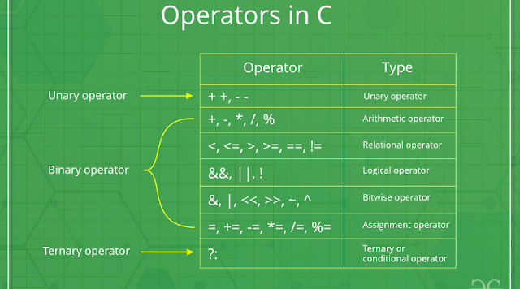

Slide 11


Slide 12

C++ Overview
If condition:
Taking decision.
If.
else if.
else.

Slide 13

C++ Overview
Loops:
Repeating
While.
do while.
for.

Slide 14
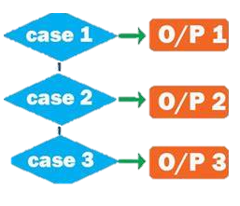
C++ Overview
Switch case:
Making decision.

Slide 15


Slide 16

C++ Overview
Function:
Do some thing
Return.
Void.

Slide 17

C++ Overview
Return:
Return something.

Slide 18

C++ Overview
Pointers:
Point on something.
pass by address.

Slide 19


Slide 20

C++ Overview
Array:
Collection of variables.
Constant size.

Slide 21

C++ Overview
Struct:
Custom array.
Can contain different data types.

Slide 22
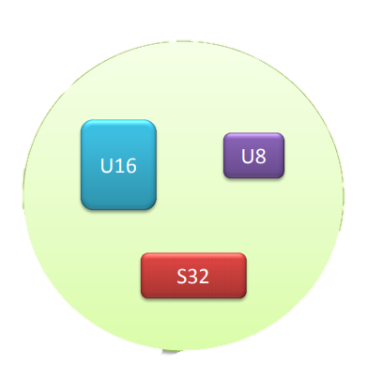

Slide 23


Slide 24
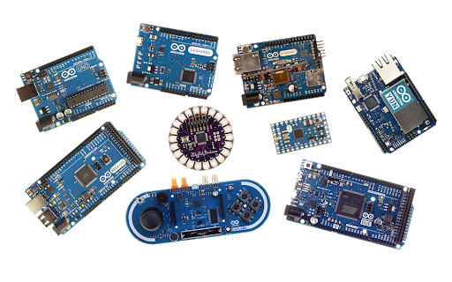
Micro controller:
Arduino types:

Slide 25
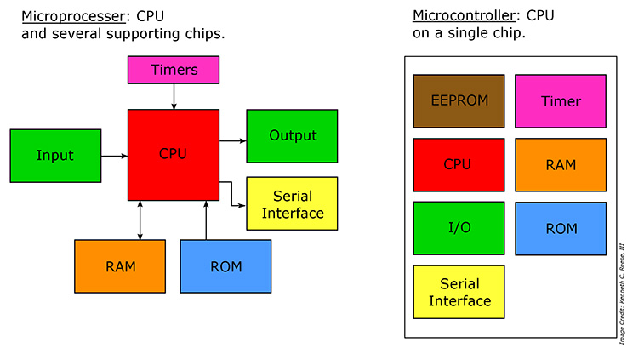
Micro processor VS Micro controller

Slide 26
Arduino Hardware

Slide 27
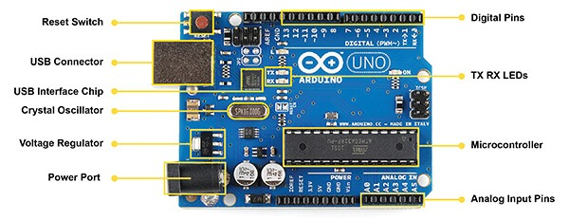

Slide 28
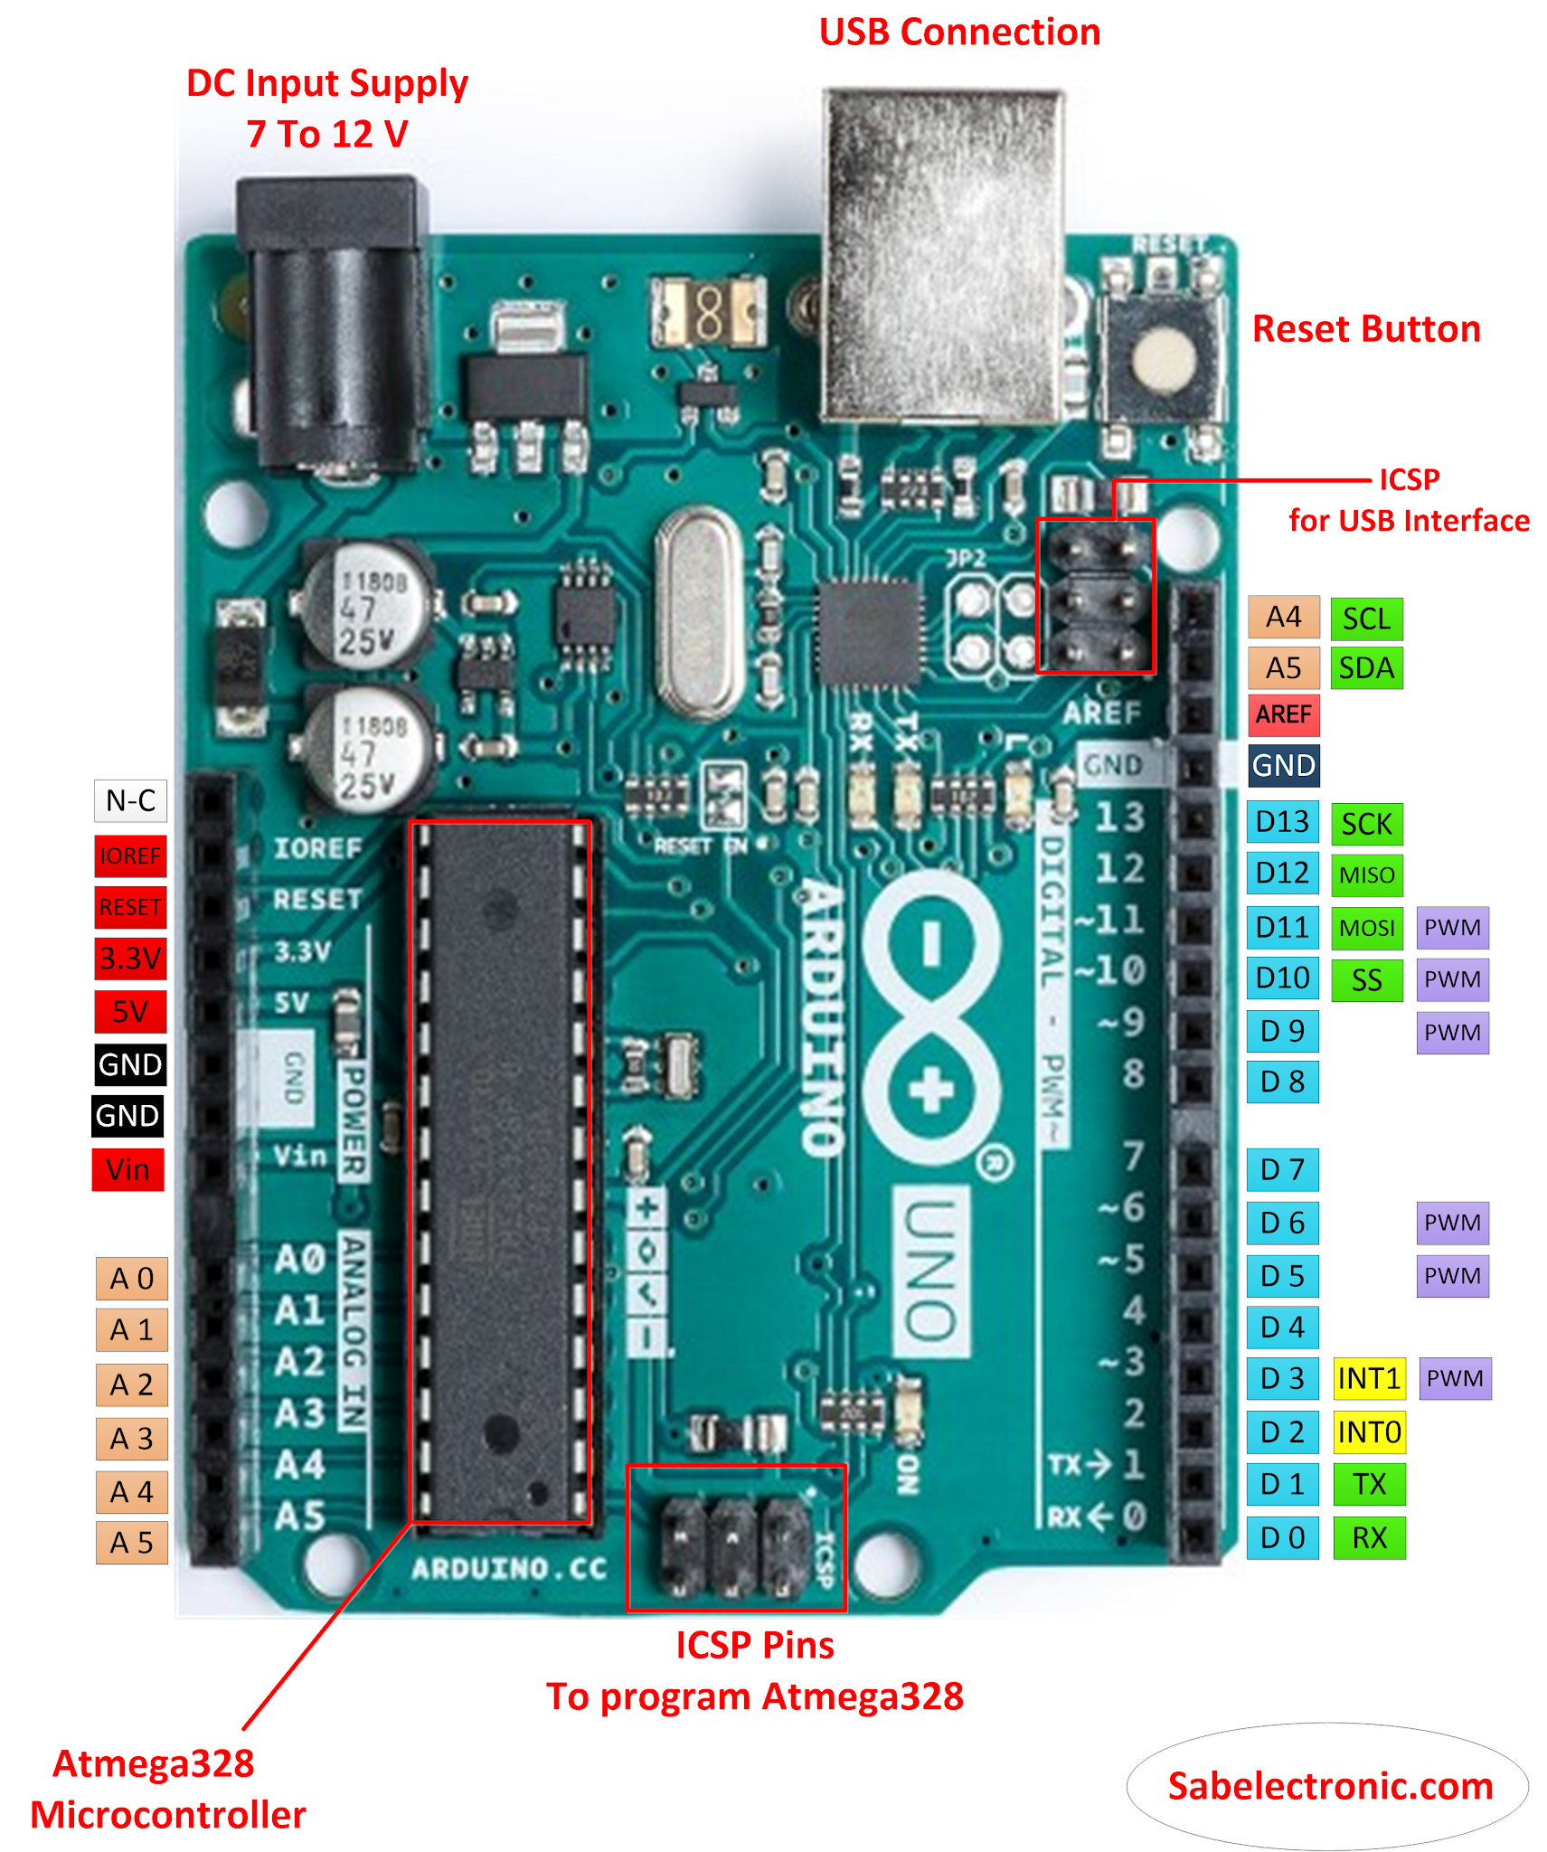
Arduino Pins:

Slide 29
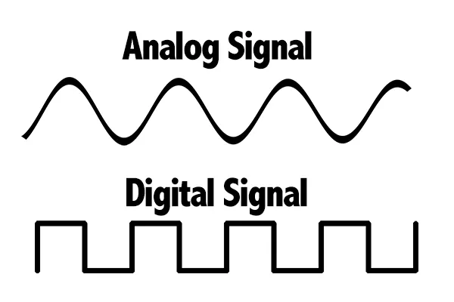
Analog VS digital

Slide 30
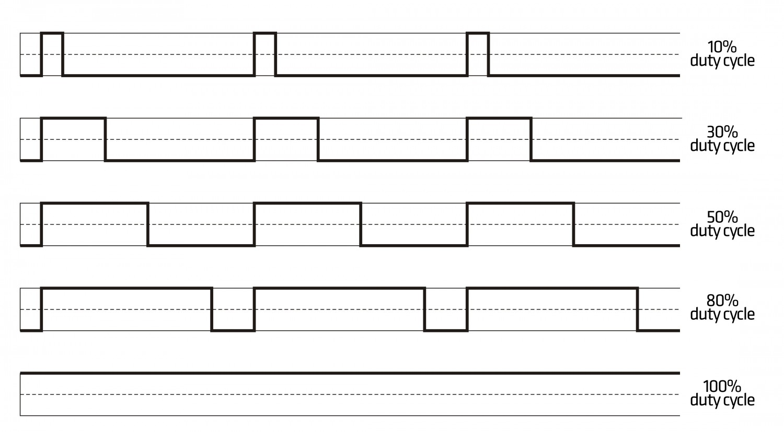
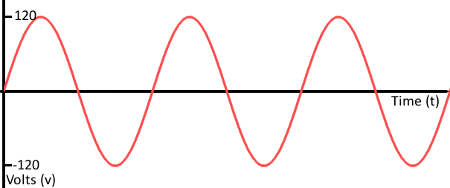
PWM VS Analog

Slide 31
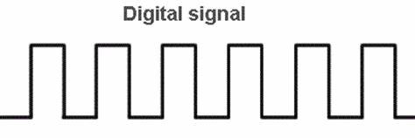
PWM VS digital

Slide 32


Slide 33
Arduino Software
Arduino IDE.
Code implementation.
Void setup.
Void loop.

Slide 34
Arduino Functions:
Hint:
digital Write (), digital Read (), pin Mode ().
Example 1:
Toggling a led using push button.

Slide 35


Slide 36
Examples:
Example 2:
Control the light intensity of a led using potentiometer.
Functions:
analog Read (), map (), analog Write (), pin Mode ().

Slide 37
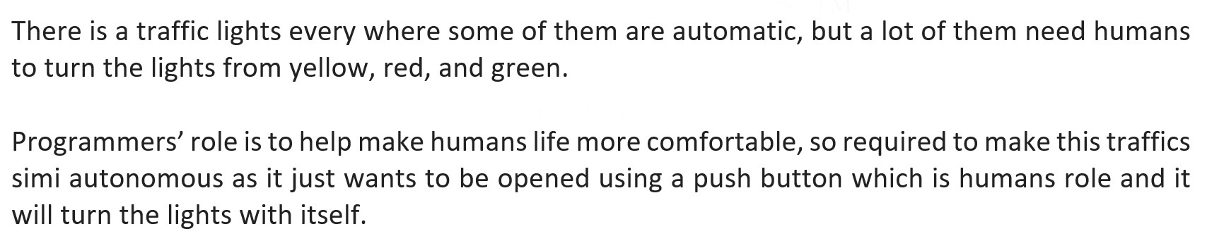
Example 3:

Slide 38
Example 3:
Hint:
Use the following functions.
digital Read(), delay (),digital Write(), pin Mode().

Slide 39
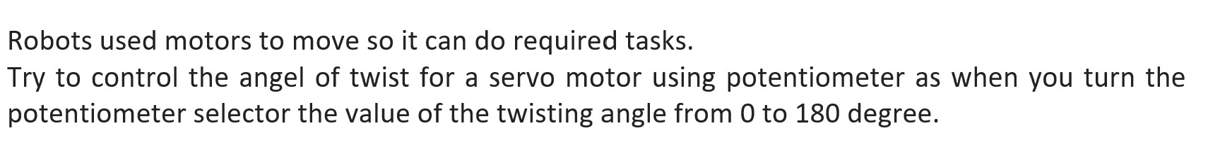
Example 4:

Slide 40
Example 4:
Hint:
Use the following functions.
analog Read (), map(), servo library (servo. attach (), servo. write ()).

Slide 41
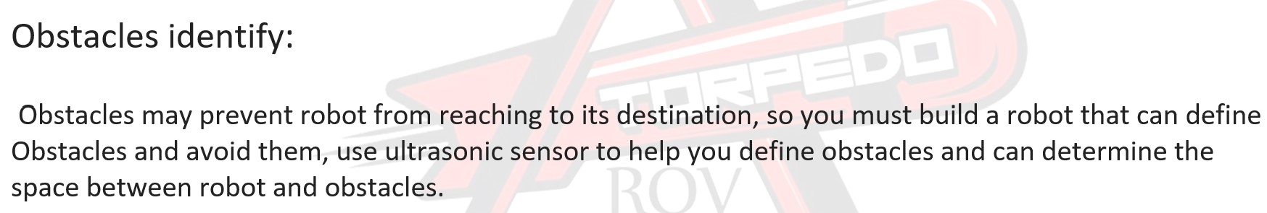
Example 5:

Slide 42
Example 5:
Hint:
Use the following functions: pinMode(), delayMicroseconds(), digitalWrite().

Slide 43


Slide 44


